Slide 1


ROAD ACCIDENT ANALYSIS AND TRAFFIC SEVERITY PREDICTION USING ADVANCED DATA MINING TECHNIQUES

Slide 2
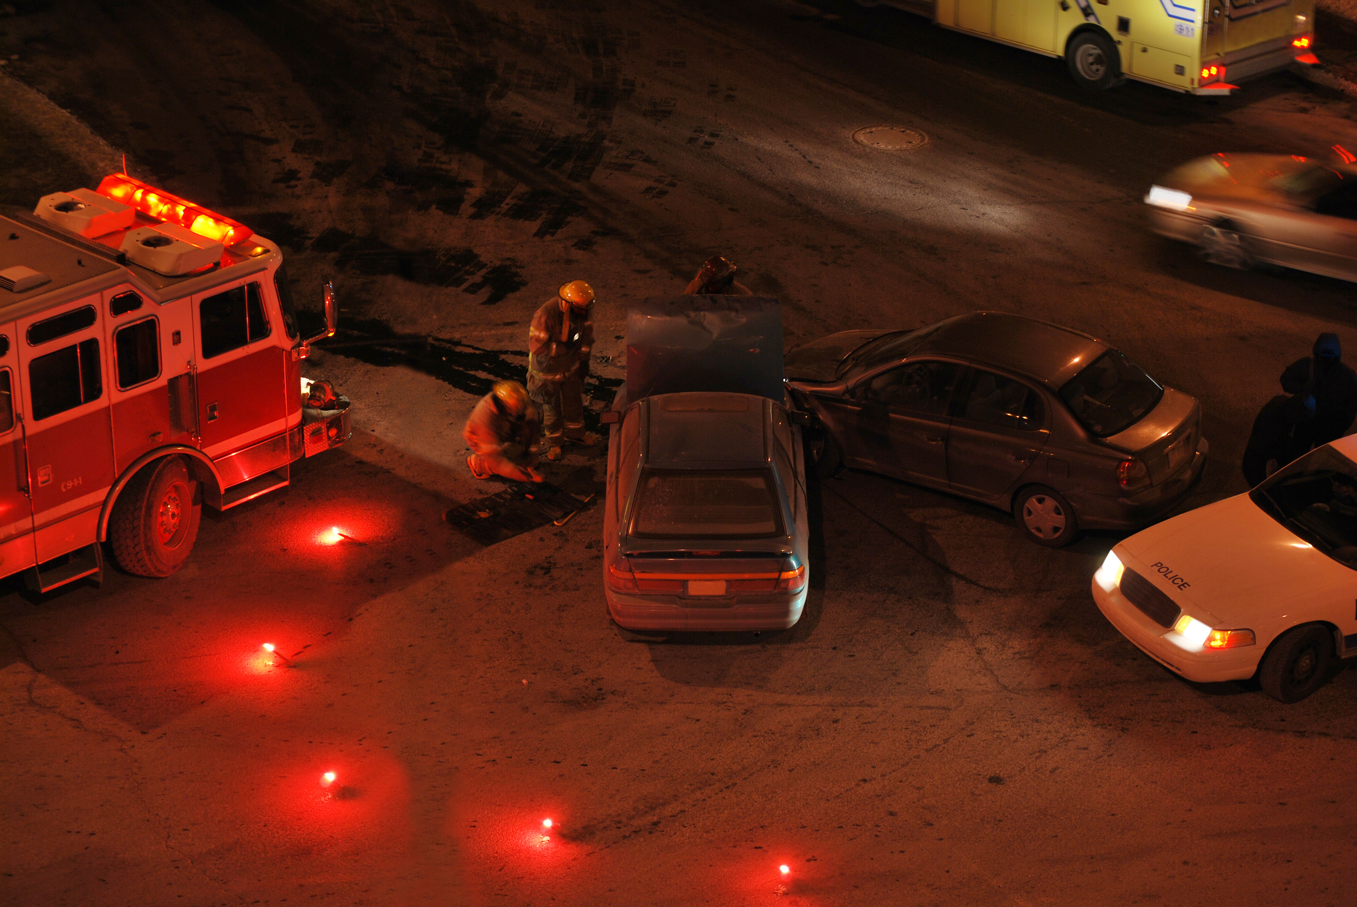








INTRODUCTION
PROBLEM STATEMENT
LITERATURE REVIEW
CONTENTS
DATA COLLECTION
METHODOLOGY
MODEL PERFORMANCE
DISCUSSION
CONCLUSION

Slide 3
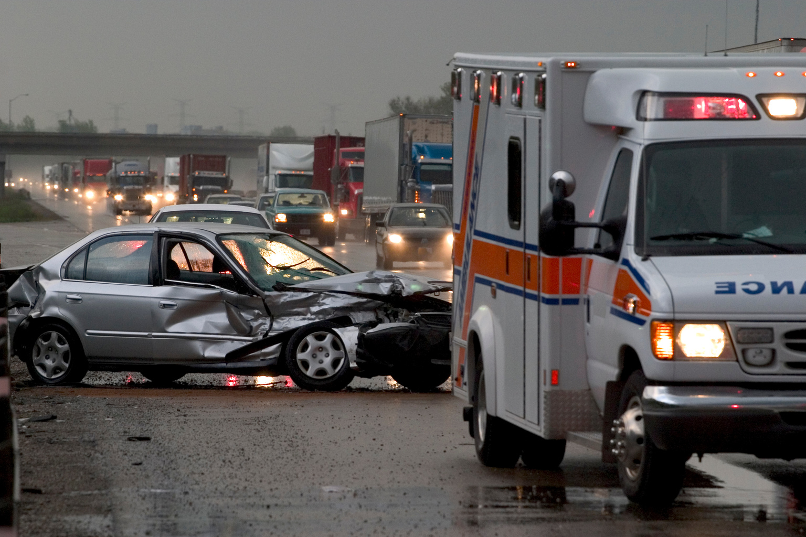
INTRODUCTION
Overview of Road Accidents:
Significant cause of death and injury worldwide.
Millions of incidents annually with substantial economic costs.
Importance of Traffic Severity Prediction:
Enhances safety measures.
Optimizes resource allocation.
Informs policy and preventive strategies.

Slide 4

PROBLEM STATEMENT
Current Challenges:
High frequency of road accidents and their severe impacts.
Difficulty in predicting accident severity accurately.
Inefficient allocation of resources and response efforts.
Research Focus:
Utilizing advanced data mining techniques to predict traffic accident severity.
Improving predictive accuracy to enhance road safety measures.

Slide 5

LITERATURE REVIEW
ADVANCED DATA MINING TECHNIQUES:
Ensemble Methods:
Random Forest & Gradient Boosting: Xie et al. (2018) highlighted feature selection and model ensembling for improved accuracy.
DL Approaches:
CNN: Zhang et al. (2019) proposed CNNs to capture complex relationships.
Methodologies in Severity Prediction:
Traditional Techniques:
Logistic Regression: AbdelAty and Radwan (2000) identified factors like driver characteristics, environmental conditions, and roadway features.
Decision Trees: Wong et al. (2004) analyzed accident data to identify critical predictors of injury severity.
Machine Learning Techniques:
Support Vector Machines (SVM): Chen et al. (2018) used SVM for predicting accident severity based on weather, road geometry, and traffic volume.
Challenges and Future Directions
Data Heterogeneity
Real-time Data
Quality Data
Algorithm Used
INTEGRATION OF SPATIAL AND TEMPORAL DYNAMICS:
Spatiotemporal Clustering: Identifies high-risk zones

Slide 6



DATA COLLECTION
Countrywide data from 49 American states (Feb 2016 - Mar 2023). Sources: APIs, traffic sensors, law enforcement, etc. Total records: ~7.7 million accidents.
DATASET SOURCE
ATTRIBUTES COLLECTED
PREPROCESSING STEPS
Kaggle: Comprehensive dataset compiled from diverse sources, ensuring high data integrity and relevance.
Accident Details: Date, time, location, and severity. Environmental Conditions: Weather, temperature, visibility, road type, and lighting.
Handling Missing Values: Imputation techniques to estimate missing data. Encoding Categorical Variables and Scaling Numerical Features for optimal performance.

Slide 7
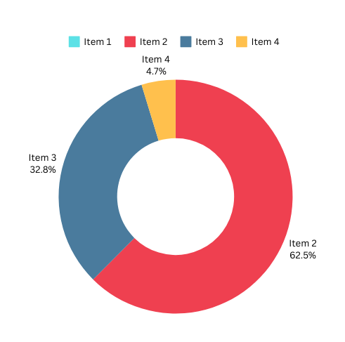
EXPLORATORY DATA ANALYSIS
MAJORITY
32.8 %
SEVERITY - 2
SEVERITY - 3
7.5%
Increase in accidents over the years, with a significant rise in the last two years.
Weekdays witness double the accident percentage compared to weekends.
Thursday registers the highest percentage of accidents.
Morning peak at 8:00 AM and evening peak at 5:00 PM for accidents.
Majority of accidents occur between 6:00 AM to 9:00 AM and 3:00 PM to 6:00 PM.
SEVERITY - 4
Los Angeles: Highest no. of road accidents (2.64%)
California: State with the highest no. of accidents.
South Dakota: Lowest no. of road accidents.
SEVERITY DISTRIBUTION

Slide 8



MODEL SELECTION:
METHODOLOGY
Utilized Support Vector Machine (SVM), Random Forest, and Gradient Boosting.
Implemented models in Python using scikit-learn, TensorFlow, and PyTorch.
Data Preparation:
Selected high-quality dataset from Kaggle.
Did a robust exploratory data analysis to find out the major factors that have the potential of determining the traffic severity level caused by the accidents.
Preprocessed data to handle missing values, encode categorical variables, and scale numerical features.
Partitioned data into training, validation, and testing sets.
PERFORMANCE EVALUATION:
Evaluated models using accuracy, precision, recall, F1-score, AUC-ROC, and AUC-PR.
Employed robust cross-validation techniques to ensure model generalization.
RESULTS AND ANALYSIS:
XGBoosting emerged as the top-performing model, followed by Random Forest and SVM.
Identified key predictors such as weather conditions and road type.
Recognized limitations and proposed future research directions.

Slide 9
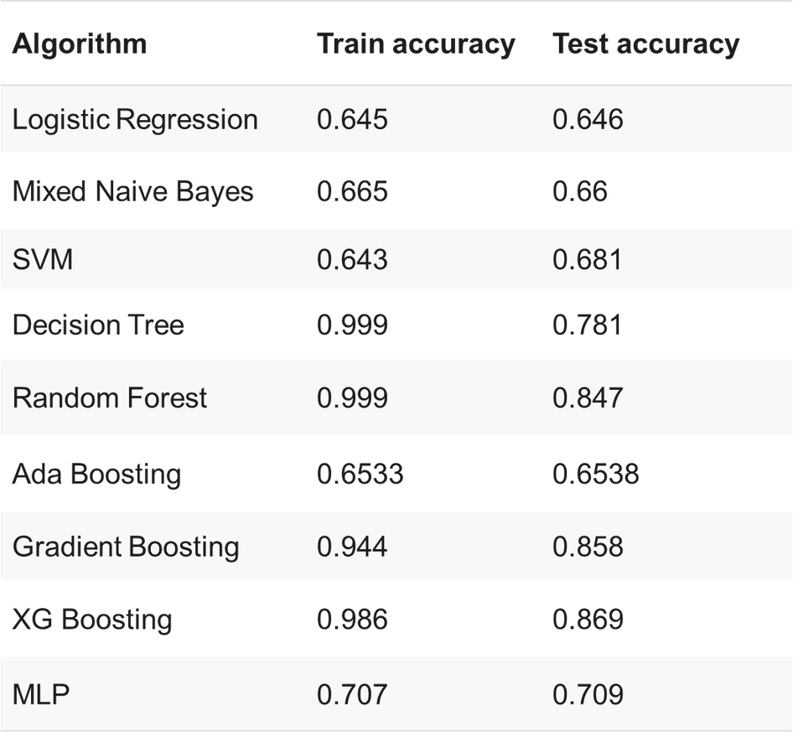

MODEL PERFORMANCE
Evaluation Metrics:
Accuracy, precision, recall, F1-score, AUC-ROC, AUC-PR.
Top-Performing Model:
Extreme Gradient Boosting (XGBoost).
Followed by Random Forest and Support Vector Machine (SVM).
Performance Comparison:
Graphical representation of performance metrics.
Highlighting strengths and weaknesses of each model.
Cross-Validation Results:
Ensured model generalization and consistency.
Insights into model stability and reliability.

Slide 10

LET’S DO SOME
Interpretation of Results:
Analysis of key predictors identified by the models.
Understanding the influence of weather conditions, road type, and time of day.
Model Limitations:
Addressed challenges such as class imbalance and feature correlation.
Discussion on areas for improvement and refinement.
Implications for Road Safety:
How insights from predictive models can inform interventions and risk mitigation strategies.
Potential impact on reducing traffic accidents and improving public safety.
DISCUSSION

Slide 11
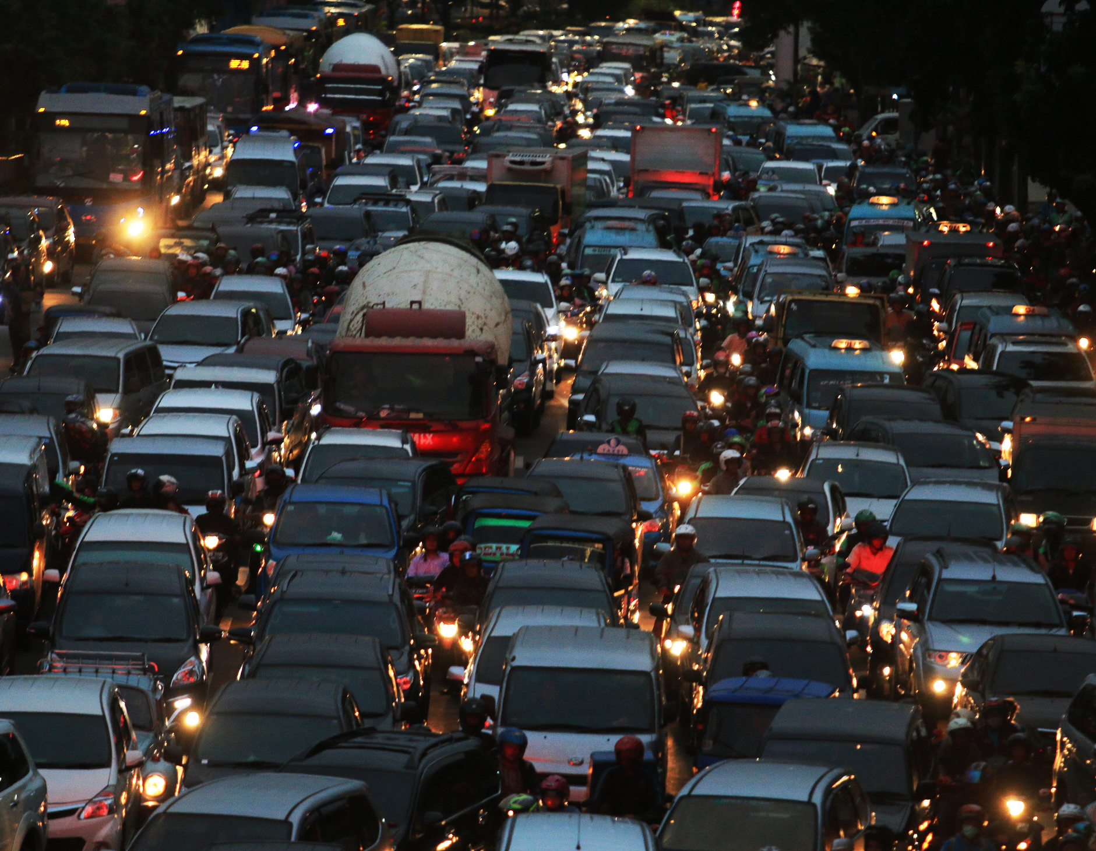
CONCLUDING
Significance of Research:
Importance of traffic severity prediction in road safety initiatives.
Potential implications for urban planning and public policy.
Future Directions:
Opportunities for further research and development.
Need for collaboration and innovation in improving predictive models.

Slide 12


THANK YOU
FOR YOUR ATTENTION.
ANY QUESTIONS?
NIHARIKA KHANNA
khanna.niharika09@gmail.com

